Slide 1
CCNA 200-301
Introduction to Controller-Based Networking

Slide 2
Objectives
Explain the role and function of network components
  Endpoints
  Servers
Describe characteristics of network topology architectures
  Spine-leaf
Explain how automation impacts network management
Compare traditional networks with controller-based networking
Describe controller-based and software defined architectures (overlay, underlay, and fabric)
  Separation of control plane and data plane
  Northbound and southbound APIs

Slide 3

Data Plane Processing on Routers: Basics

Slide 4
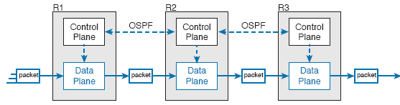
Control and Data Planes of Routers— Conceptual

Slide 5
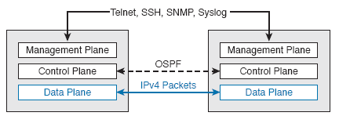
Management Plane for Configuration of Control and Data Plane

Slide 6
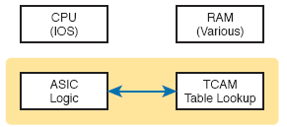
Key Internal Processing Points in a Typical Switch

Slide 7
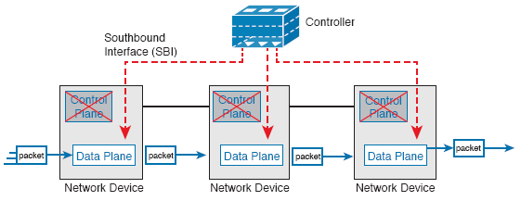
Centralized Control Plane and a Distributed Data Plane

Slide 8
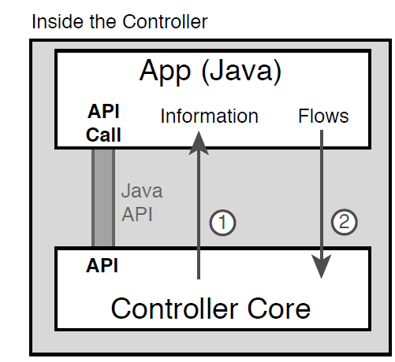
Java API: Java Application Communicates with Controller

Slide 9
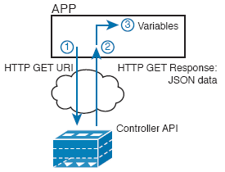
Process Example of a GET Using a REST API

Slide 10
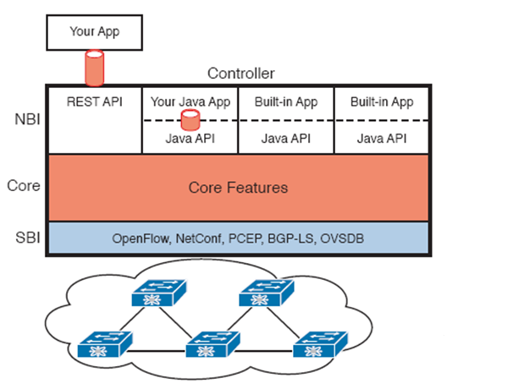
Architecture of NBI, Controller Internals, and SBI to Network Devices

Slide 11
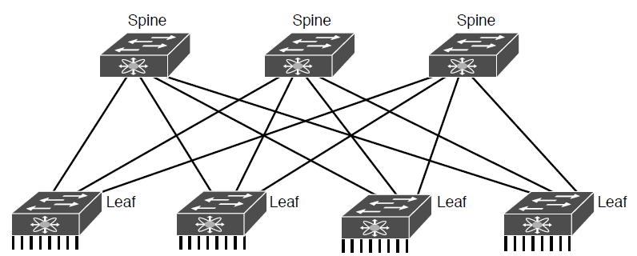
Spine-Leaf Network Design

Slide 12
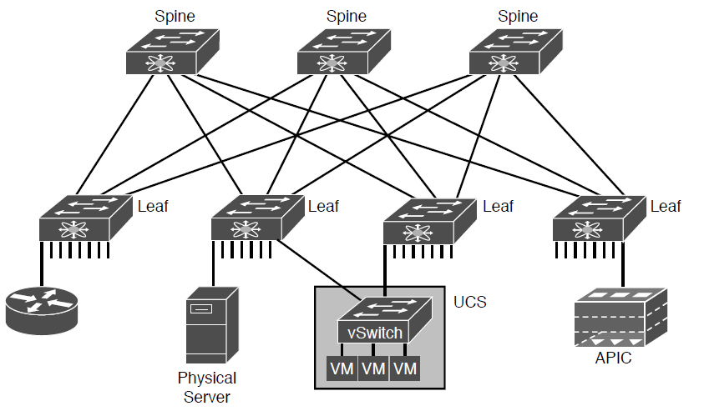
Endpoints Found on the Leaf Switches Only

Slide 13
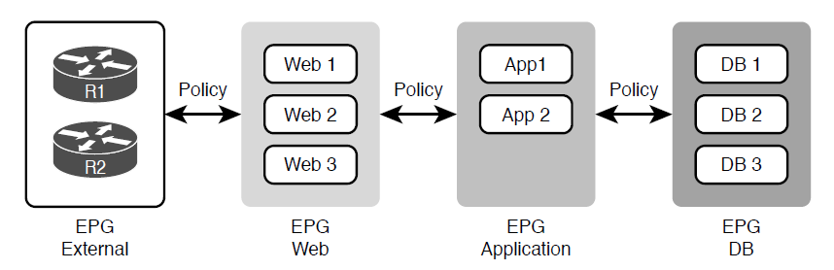
Endpoint Groups (EPGs) and Policies

Slide 14
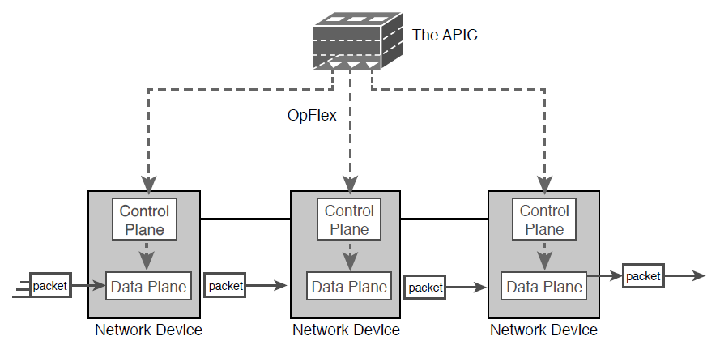
Architectural View of ACI with APIC Pushing Intent to Switch Control Plane

Slide 15
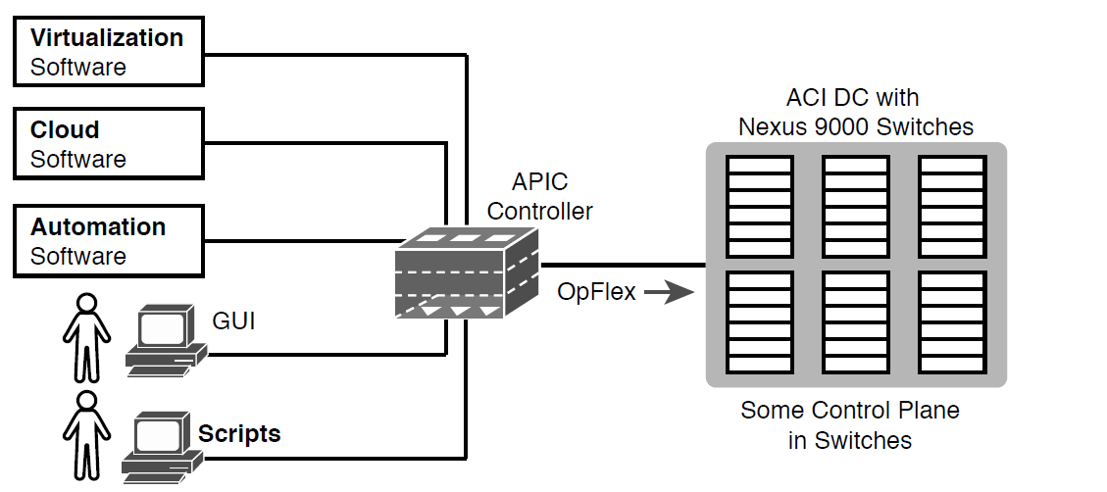
Controlling the ACI Data Center Network Using the APIC

Slide 16
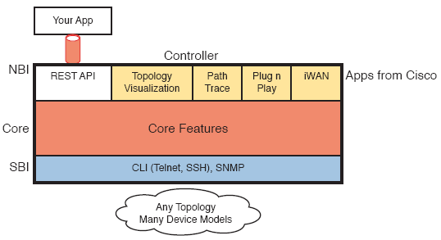
APIC-EM Controller Model

Slide 17
Points of Comparison: OpenFlow, ACI, and APIC Enterprise
Criteria | OpenFlow | ACI | APIC Enterprise
Changes how the device control plane works versus traditional networking | Yes | Yes | No
Creates centralized point from which humans and automation control the network | Yes | Yes | Yes
Degree to which the architecture centralizes the control plane | Mostly | Partially | None
SBIs used | OpenFlow | OpFlex | CLI/SNMP
Controllers mentioned in this chapter | OpenDaylight | APIC | APIC-EM
Organization that is the primary definer/owner | ONF | Cisco | Cisco

Slide 18
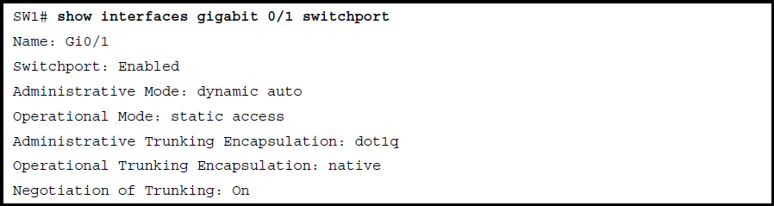
Small Output from a Switch Command

Slide 19

Python Dictionary with Variables Set to Needed Values

